Slide 1
FlixScrawler
Maria Kubara & Kamil Matuszelański

Slide 2
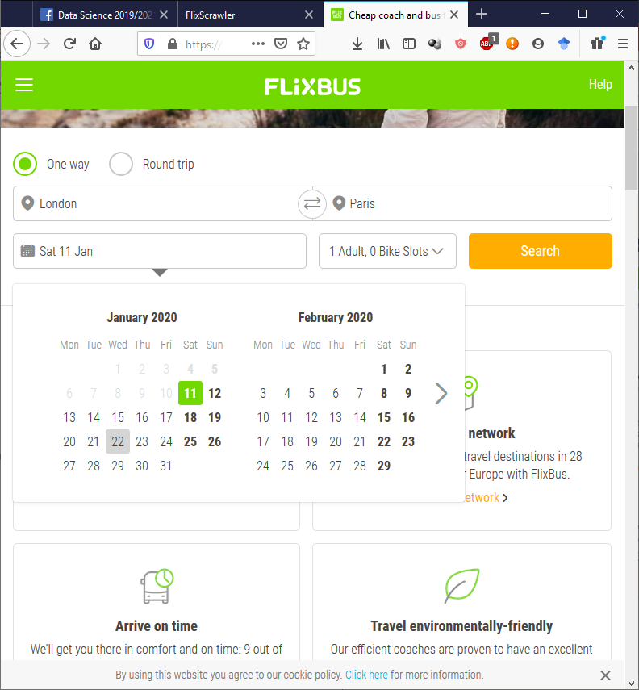
Cheap Travels?
Many routes
Low prices
Many special offers

Slide 3
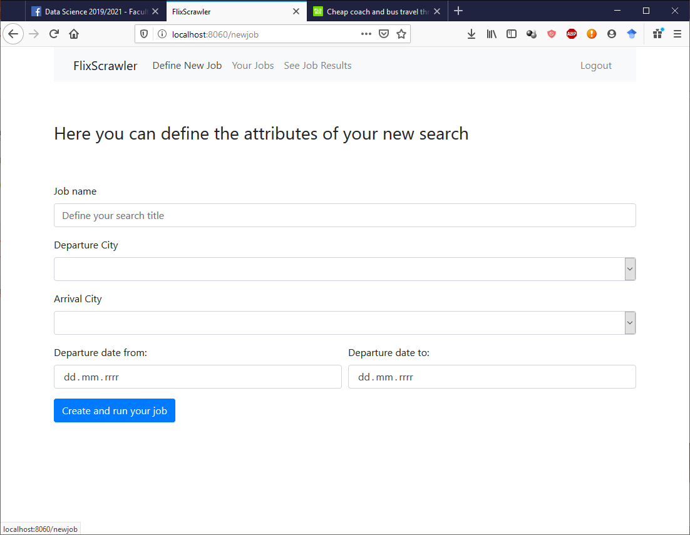
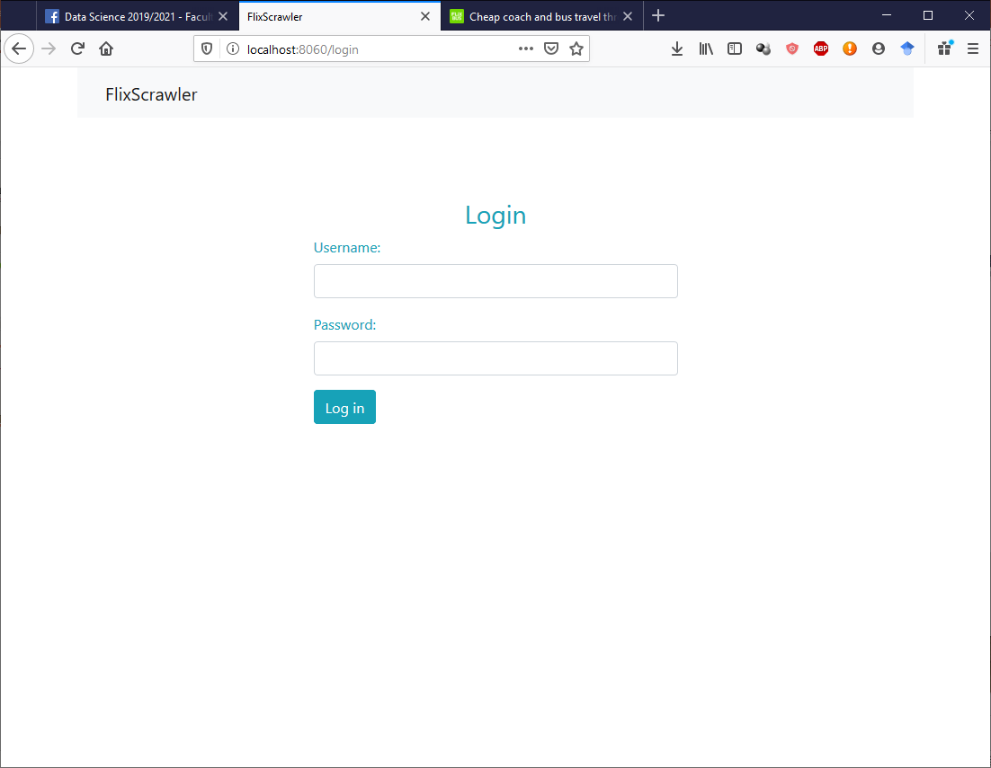
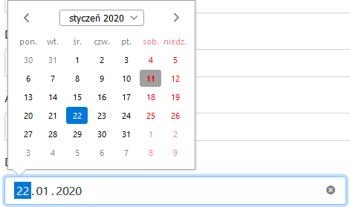
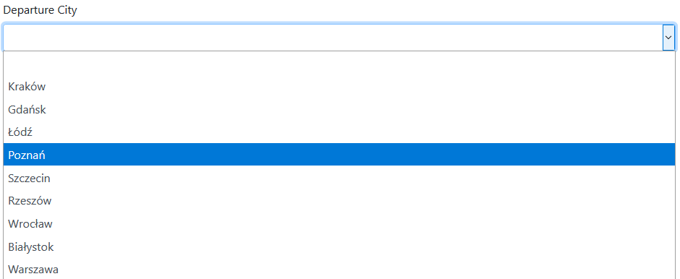
login and Define your new search

Slide 4
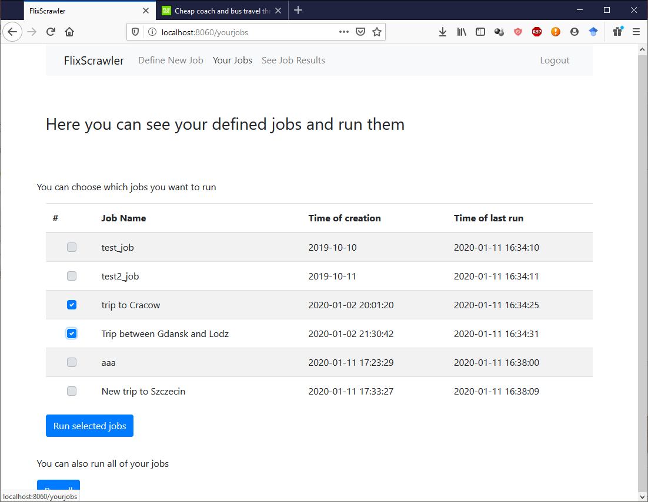
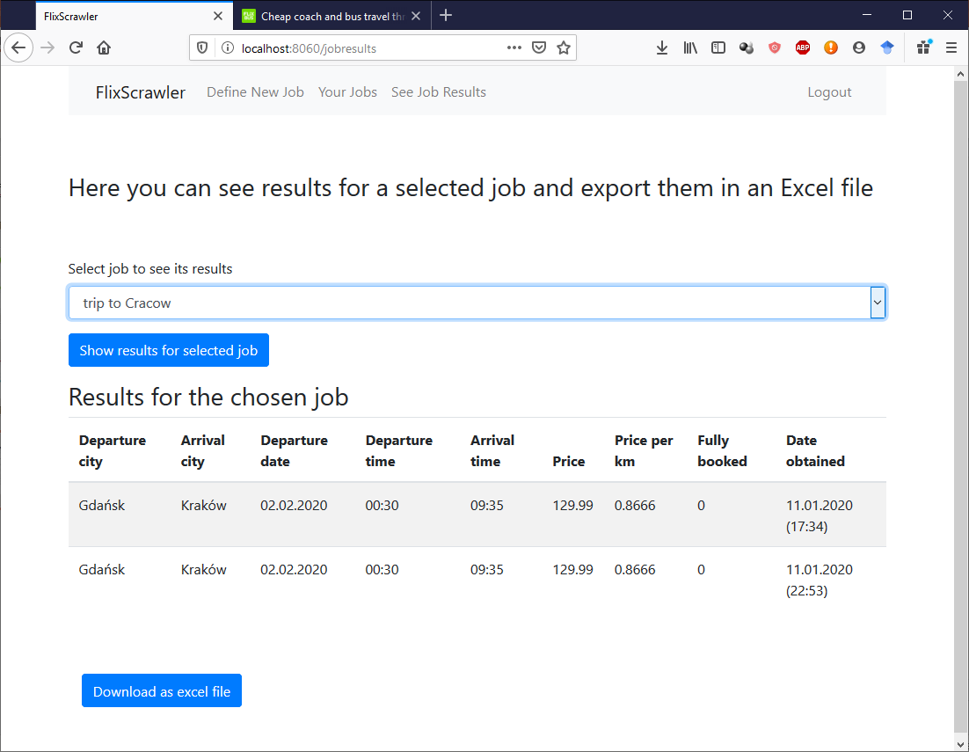
Easily Get and export your data

Slide 5
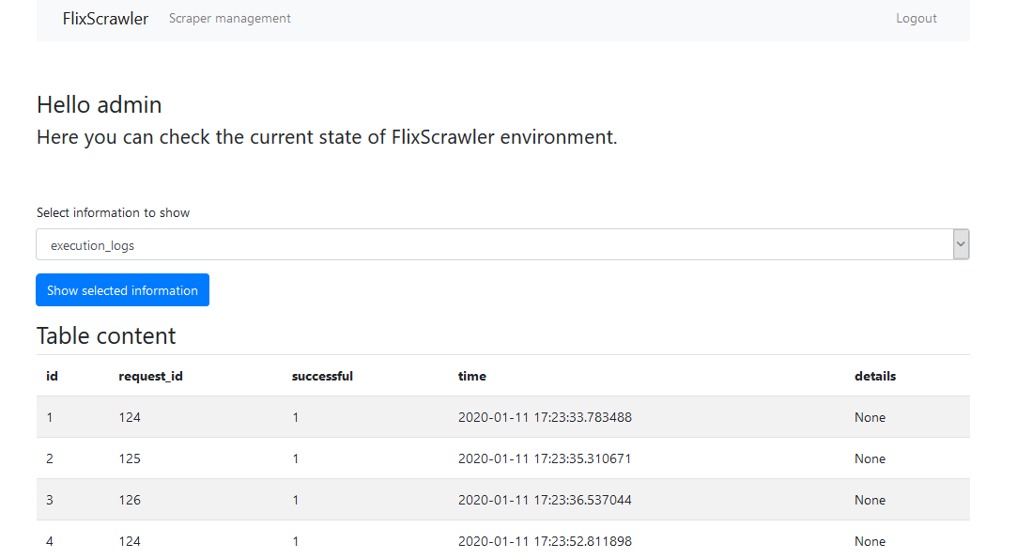
Admin view

Slide 6
Our teamwork for better analytic tools
Maria | Kamil
Draft of the written project proposal | Database outline and entity diagram
Building the back-end of the webapp in python and preparing the base.tmp view file | Building the scrawler in python
Integrating webapp with the database | Integrating scrawler with database
Preparing user’s views and according templates | Preparing admin’s views and its bottle templates
Preparing the authentication mode (with login and logout page) and xlsx export module | Preparing SQL actions triggered by each scrawler use
Building selects and joins used for all the user views | Preparing an SQL view and selects used in admin page
Preparing the presentation 50% | Preparing the presentation 50%
Explaining the purpose of a project and its general description | Explaining the code-specific features, mainly the scrapper work
Writing the report 50% | Writing the report 50%

